Slide 1
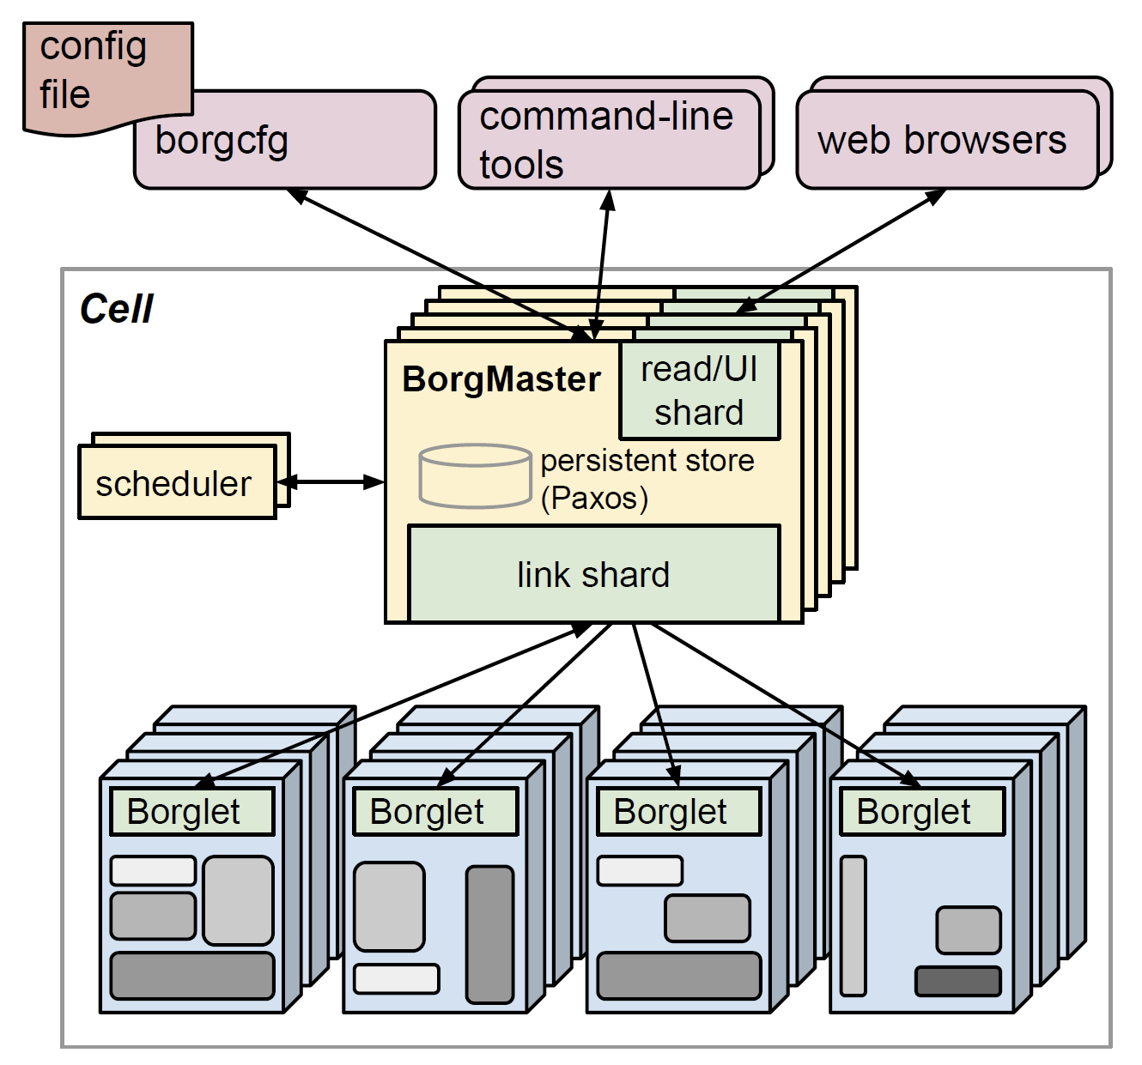
Borg and Omega
https://bit.ly/B23444

